Slide 1
EGOCENTRIC ASSEMBLY MONITORING
THE LOOP
DETECT
The Mistake Loop
Detecting, attributing, and recovering from execution errors
in first-person build & assembly video
1
ATTRIBUTE
2
RECOVER
3
An event-triggered error-detection + VLM attribution architecture — what inspired it, where it works today (CaptainCook4D), why IndustReal forced the change, and where it goes next.
AIOps research · Architecture & evaluation review · July 2026

Slide 2
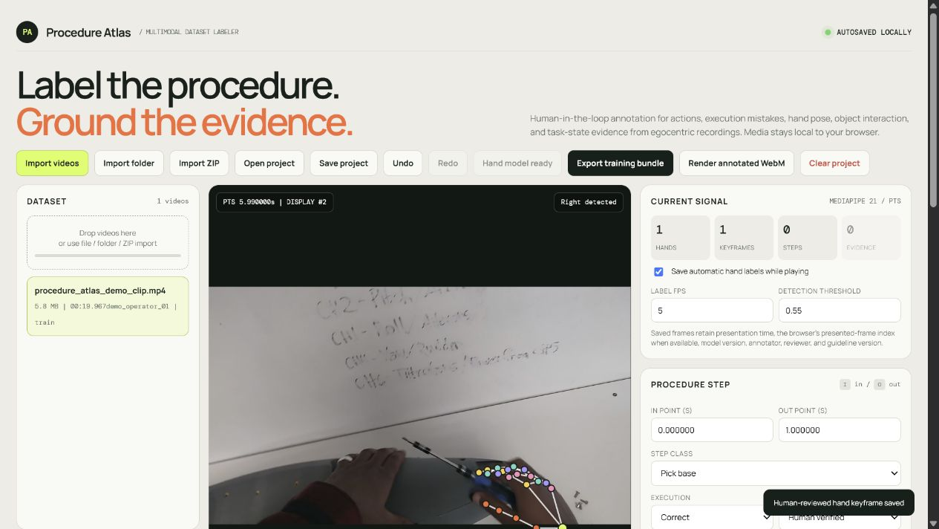
The labeling app creates the supervision the detector needs
P0 — ALWAYS ON
One synchronized timeline
Action segments
Execution outcome
Structured mistake evidence
Reviewed 21-joint hand pose
P1 — OPTIONAL
Object/tool events, task-state changes, recovery events, and synchronized sensor references can be enabled only when supported.
02
Notes:
[Sources]
- web/labeler.html
- docs/deliverables/hand_atlas_report/procedure_atlas_dataset_labeling_report.tex
- docs/deliverables/hand_atlas_report/figures/procedure_02_hand_overlay.png
[/Sources]

Slide 3
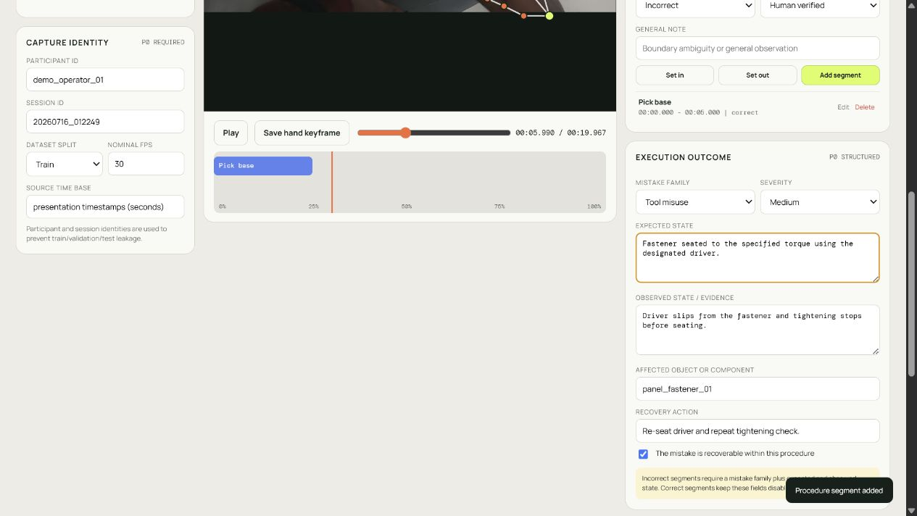
Mistakes become machine-readable evidence
Required for an incorrect segment
1
Mistake family
wrong part, order, orientation, tool misuse…
2
Expected state
what should be true after the step
3
Observed evidence
what contradicts that expectation
4
Recovery
what restores a valid procedure state
03
Notes:
[Sources]
- web/labeler.html
- docs/deliverables/hand_atlas_report/figures/procedure_03_structured_mistake.png
[/Sources]

Slide 4
PROCEDURE ATLAS / MISTAKE LOOP
The training bundle turns annotation into aligned model inputs
1. Annotate
2. Validate
3. Export
4. Train / evaluate
Actions, outcomes,
hands, optional P1
Ranges, taxonomy,
provenance, leakage
Temporal JSONL,
CSV, COCO, splits
Time-aligned evidence
on one procedure schema
Shared contract
stable step IDs • canonical presentation timestamps • participant/session-disjoint splits • versioned guidelines
04
Notes:
[Sources]
- web/labeler.html
- src/aiops/inference/pipeline.py
- docs/deliverables/hand_atlas_report/procedure_atlas_dataset_labeling_report.tex
[/Sources]

Slide 5
Where the mistake loop fits
The monitor answers five questions from a live egocentric stream — the loop owns questions 3–5.
OWNED BY THE MISTAKE LOOP
1
2
3
4
5
Correct step?
Correct tools & parts?
Done the correct way?
What was the mistake?
How to recover?
procedure / step recognition
symbolic selection check
execution-error detection
VLM attribution
task-graph recovery planner
One design invariant: the loop enriches, it never gates.
●
Event-triggered
●
Non-blocking
●
Graceful
Runs only when a detector fires — attribution is off the real-time critical path.
A VLM 'no error' verdict is logged as disagreement, never a silent suppression of the alert.
A malformed model reply is coerced or isolated per-event; one bad event never sinks a batch.

Slide 6
Architecture of the mistake loop
Six swappable Protocol stages over the StateVerify decomposition — every stage disconnects and iterates independently.
UPSTREAM EVIDENCE (StateVerify decomposition)
Action / Step Expert
→
Component Evidence Observer
→
Typed Belief Tracker
procedure residual
execution + effect residual
fuses residuals → confirmed fault
↓ confirmed fault event
ADJUDICATION PIPELINE
1
›
2
›
3
›
4
›
5
›
6
Trigger
Evidence
Prompt
VLM Backend
Parser
Fuser
which events
frames + state + context
model-agnostic
Qwen2.5-VL
validated JSON
attach, never suppress
Structured output
ATTRIBUTION_SCHEMA
has_error · mistake_family · subtype · description · expected · observed · violated_role · evidence · confidence · rationale

Slide 7
What inspired it
Four ideas, chosen because the data said discriminative error classifiers cannot be learned from scarce faults.
A
Learn normal, flag deviation
B
Manufacture the missing supervision
An expected-effect / expected-normal model trains on abundant CORRECT executions; the residual is divergence from expected. No dependence on rare error labels.
A counterfactual error engine synthesizes hard wrong-part / wrong-target / wrong-effect negatives, so the incorrect classes and a margin-ranking loss are actually exercised.
C
Attribute with a reasoning VLM
D
Route by fault type, not one detector
Event-triggered chain-of-thought adjudication (after TI-PREGO) turns a scalar alarm into a named mistake — the enrichment a detector cannot give.
The cross-dataset finding: semantic faults are learnable; spatial/geometric faults are 2-D-invisible. Different regimes need different evidence — so the loop is modular.

Slide 8
Why we changed the evaluation dataset
IndustReal recognition is healthy — but held-out error detection hit a structural wall, twice-confirmed.
THE BLOCKER (official + operator-disjoint splits)
2.5%
0%
Independently corroborated
A separate codebase (psr_tas), same IndustReal data
installed_incorrect state F1
complete_incorrect effect F1
TYPE-head incorrect-install recall
0 / 19
~0.65
0.0%
10.1%
motion features
+ semantic fusion
held-out errors caught @ ≤0.5 FA/min
AUC ceiling across ALL 2-D evidence
"Correctness is data-limited, not architecture-limited."
Bigger encoders (L14) and better heads did not move it. The lever is more, sharper error labels — which motivated moving evaluation to an error-dense dataset.
Two structural causes — neither is tuning:
Scarcity — only ~19 real error events; a 4-recording overfit hits 66.7 F1, so the branch fits faults — it can't generalise from 19.
Invisibility — pin / orientation / connection faults are geometric; no 2-D encoder (motion, ConvNeXt, Grounding DINO, SAM3, InternVideo2) exceeds ~0.65 AUC.

Slide 9
CaptainCook4D validates the architecture
An error-dense egocentric dataset: 5,413 step segments · 1,683 real errors (31%) · 8 categories · 8 persons (≈88× IndustReal).
WHAT IT SHOWS
●
Feature family is decisive
A semantic backbone lifts the supervised detector +0.08–0.12 AUC over motion, which sits at chance for these errors.
●
Our detector wins when data/features are weak
Expected-normal is backbone-robust (0.56–0.60) and beats the supervised head in the weak regime — exactly the IndustReal regime.
●
Balanced, usable errors
Per-category recall ≈0.63–0.78 at ~40% precision — vs IndustReal's ~0–2.5% F1. The method works where the error is visible.
Chance = 0.50. Semantic features (InternVideo2) + our expected-normal detector reach the achievable band.

Slide 10
Naming the mistake — first attribution results
Qwen2.5-VL adjudicator on held-out CaptainCook4D error events (chain-of-thought, no ground-truth leakage).
1.00
0.375
0.40
0.96
coverage
family accuracy
description token-F1
mean confidence
every event returns a valid, schema-checked attribution
3× the 1-in-8 chance baseline
free-text 'what happened' overlap with ground truth
well-formed, decisive outputs
Descriptions land even when the family is wrong
Failure mode → fix (prompt-only)
Predicted: "cracked the egg on the counter instead of the bowl"
Bias: "Missing Step" over-predicted (5/8) — any unmet-goal deviation got that label.
The core objective — 'what was the mistake' — is already being answered in natural language; the structured family label is the part still being tuned.
Fix: injected family definitions + an omitted-vs-attempted disambiguation rule + leakage-free few-shot exemplars — all swappable, no backend/schema change.

Slide 11
The architecture we're betting will move the needle
Stop asking one frozen-feature scalar head to carry error detection. Make the task graph the spine and the VLM a grounded verifier.
●
Task-graph–first
●
Unused state track
●
VLM as grounded verifier
A first-class procedure graph with pre/post-conditions. A Graph-Consistency Auditor catches skip / mis-order / omission errors with ZERO error labels — side-stepping scarcity.
IndustReal's OD_labels part-presence (26,925 dense frames) becomes the observed state the expected-effect residual compares against — a real measurement, not a proxy.
Given before/after frames + expected-vs-observed state, the VLM verifies 'correct way' where frozen linear probes are at chance — a genuinely un-exhausted lever.
●
REMOVE as a recovery signal
●
Recovery planner
●
3-D / orientation evidence
REMOVE is NOT data-limited (~69% recall). Promote it to a first-class channel — it is literally a recovery action and seeds the recovery planner.
On a confirmed fault, search the graph for the shortest safe path back to a valid state; the VLM narrates but cannot invent unapproved operations.
The one untested lever for the spatial-fault regime that no 2-D feature can see — the long pole for IndustReal-style geometry faults.

Slide 12
Designing the engine dataset
The forthcoming self-collected engine-assembly capture is the real target. IndustReal failed at 19 errors; CaptainCook4D worked at 1,683. Collect for that.
HOW MUCH — plan for the error budget, not just hours
Labeling to add (Hand Atlas)
150–400
≥ 8–10
✓
Coarse STEP timeline
recordings
operators
≥ CaptainCook4D-scale coverage
for person-disjoint evaluation
~10–20 well-separated steps — the achievable ~80% target
✓
Per-completion TYPE
≥ 1,000
~30%
correct / incorrect / remove, at the annotated instant
✓
Error family + free-text description
labeled error instances
step error prevalence
the ground truth the VLM attribution is scored against
≥300 floor to escape starvation
stage mistakes deliberately
✓
Assembly-STATE track
per-frame part-presence → data-free order/skip auditing
Balance across fault families — aim for a few hundred instances per major type (wrong part, wrong orientation, wrong order, omission, wrong tool). Rare-per-type is what killed IndustReal, not total hours.
✓
3-D / orientation flag
where a fault is a pose property — the spatial lever
✓
Recovery action sequence
the correcting steps after a mistake → trains recovery

